Slide 1
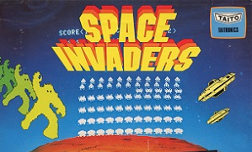
Space Invaders
By Luke Martin

Slide 2
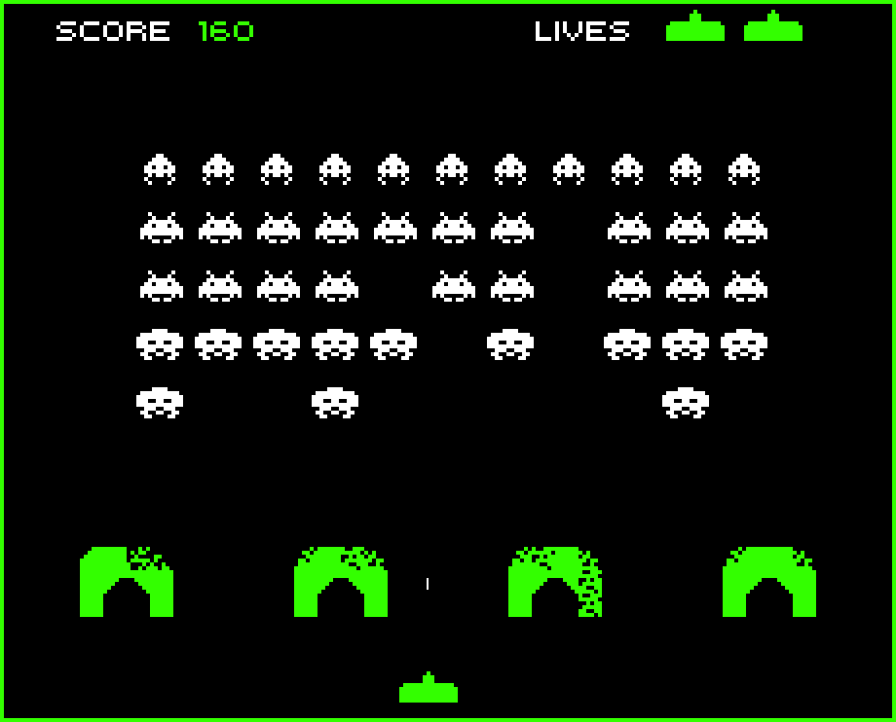
What makes a Space Invader?
A cannon
Aliens
Shells
Stone bridges
A score monitor

Slide 3
What makes a Space Invader?
A cannon
Aliens
Shells
Stone bridges
A score monitor

Slide 4
What makes a Space Invader?
A cannon
Aliens
Shells
Stone bridges
A score monitor

Slide 5
What makes a Space Invader?
A cannon
Aliens
Shells
Stone bridges
A score monitor

Slide 6
What makes a Space Invader?
A cannon
Aliens
Shells
Stone bridges
A score monitor

Slide 7
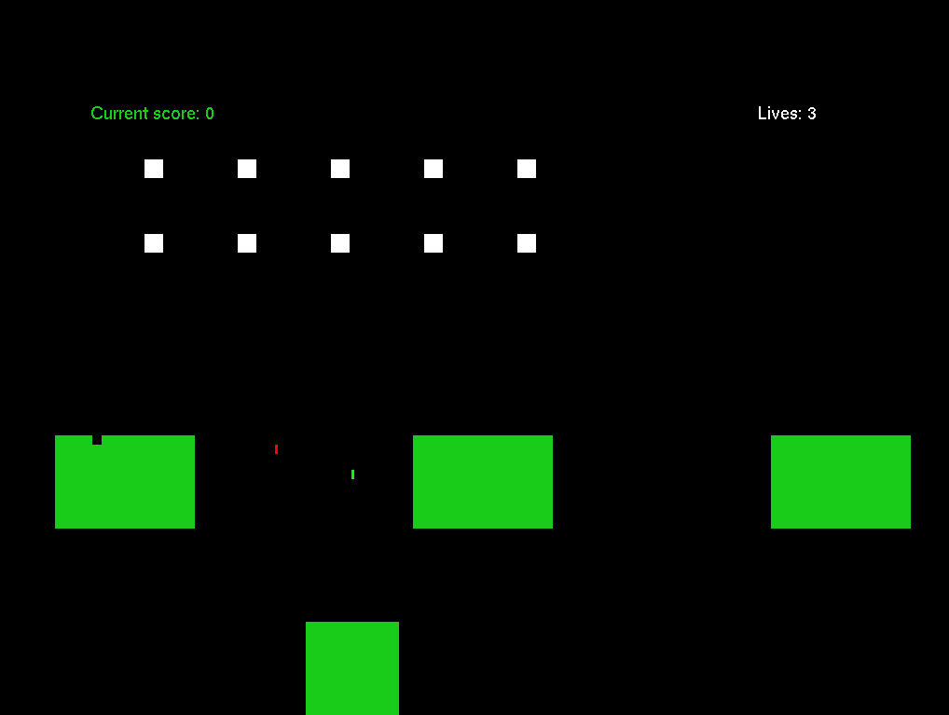
Implementation
A cannon
Aliens
Shells
Stone bridges
A score monitor

Slide 8
Inheritance and Data Org.
Drawable
Draw()
Print()
_name
DrawList = std::list<drawable*>
_pos
_speed
update()
checkCollision()
Game Objects
Line
Text
Pixel
GameList = std::list<GameObject*>
Alien Swarm:
AlienList
Bridge:
BrickList
Alien
Brick
Tank
Bullet

Slide 9
Movement and Updating
Using the Update(int dT) function from GameObjects
Position 1
Position 2
Moving Object
Moving Object
Pos 2 = Pos 1 + dT*V

Slide 10
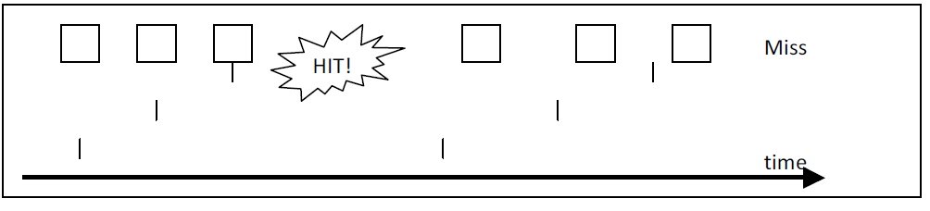
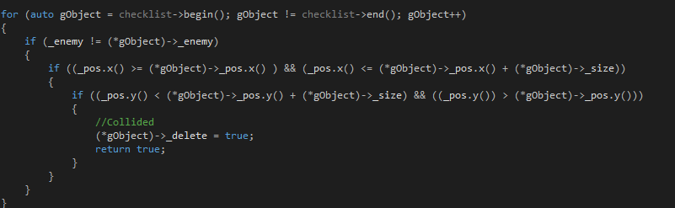
Collision
Loop through the list of objects to be checked
Is it an enemy?
Does this object fall within a range of X values
Does this object fall within a range of Y values
Tell the object it has been hit

Slide 11
User Input
Button State
Using:
glutSpecialFunc();
Calls a function when an arrow key is pressed
glutSpecialUpFunc();
Calls a function when an arrow key is pressed
OFF
Pressed
Released
ON

Slide 12
Demonstration

